Slide 1
Strategic and Change Management
Presented
by
Dennis Smith - CM(SA)
20/02/16

Slide 2
Models of Strategic Decision Making
Incremental approaches
The Rational- Comprehensive Approach The Rational-Comprehensive approach is closest to full, systematic corporate planning. Administrators work through policy alternatives and evaluate them against stated criteria. This is called the ‘Root method’.
The Successive- Limited Comparisons Approach The Successive-Limited Comparisons approach takes the current position and develops strategy in small steps. It does not go right back to assessing objectives and values. This is the ‘Branch method’.
Effective business leaders agree that the context for business has changed - therefore strategic planning sessions require a fresh approach, a new methodology, a process that would lead to better outcomes

Slide 3
three camps of strategists for the new business environment:
Those with an operational efficiency focus, and who prefer models that would include re-engineering, time-based competition, benchmarking and total quality management (TQM);
Those with a future focus, who aim to identify the most critical factors for future success. This includes applying the tried and tested competitive strategy analysis models of Michael Porter and others, or the Hamel and Prahalad scenario analysis and developing industry foresight (the latter often applied by Clem Sunter of Anglo American, who is widely regarded as an expert in this field);
Those who prefer a behaviour and culture focus, which includes data-free planning based on a vision that would in fact create cognitive dissonance. The theory is that this will ensure a more energised organisation that would move towards realising its idealised, dream position. Organisational learning, the theories and viewpoints of Peter Senge and others, are included in the developing of these strategic insights.

Slide 4
Gary Hamel in his article “Strategy as Revolution” (Harvard Business Review, JulyAugust 1996) says: “Giving planners’ responsibility for strategy is like asking a bricklayer to create Michelangelo’s Piéta”.
This implies that strategies which are well implemented are firstly professionally facilitated by external consultants.
These professionals are able to stimulate and channel the strategic thinking process to higher levels of insight and understanding. This, to a large extent, determines the effectiveness of the strategic planning process.

Slide 5

3.1
From Thinking Strategically about the Company’s Situation to Choosing a Strategy
Thinking
strategically
about a firm’s
external
environment
Forming a
strategic
vision of
where the
firm needs to head
Identifying
promising
strategic
options
for the firm
Selecting the
best strategy
and business
model for the firm
Thinking
strategically
about a firm’s
internal
environment

Slide 6
WHAT DO WE MEAN BY STRATEGY?
What is our present situation?
Business environment and industry conditions
Firm’s financial and competitive capabilities
Where do we want to go from here?
Creating a vision for the firm’s future direction
How are we going to get there?
Crafting an action plan for heading the firm in the intended direction, staking out a market position, attracting customers, achieving the targeted financial and market performance, and getting the firm where it wants to go is its strategy.
Strategy is about competing differently from rivals—doing what competitors don’t do or, even better, doing what they can’t do!

Slide 7
WHAT IS STRATEGY ABOUT?
Strategy is all about How:
How to attract and please customers.
How to compete against rivals.
How to position the firm in the marketplace.
How best to respond to changing economic and market conditions.
How to capitalize on attractive opportunities to grow the business.
How to achieve the firm’s performance targets.

Slide 8
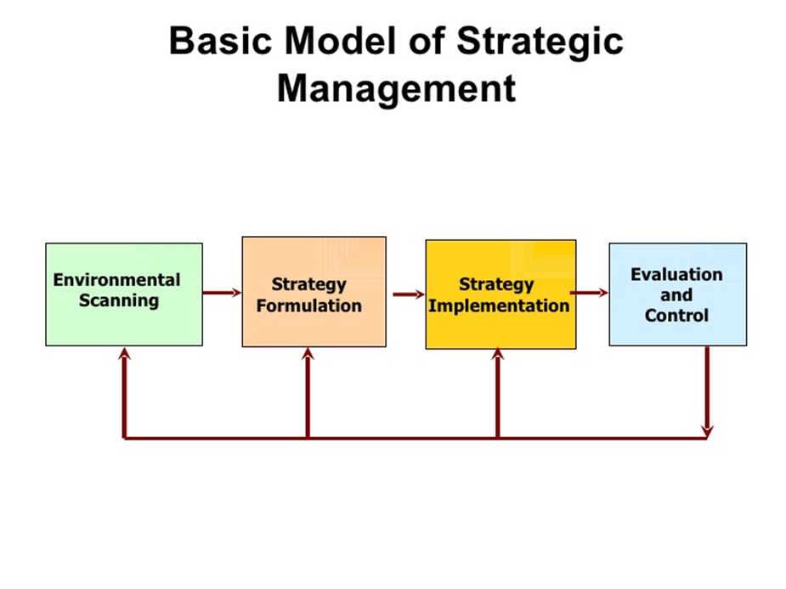

Slide 9
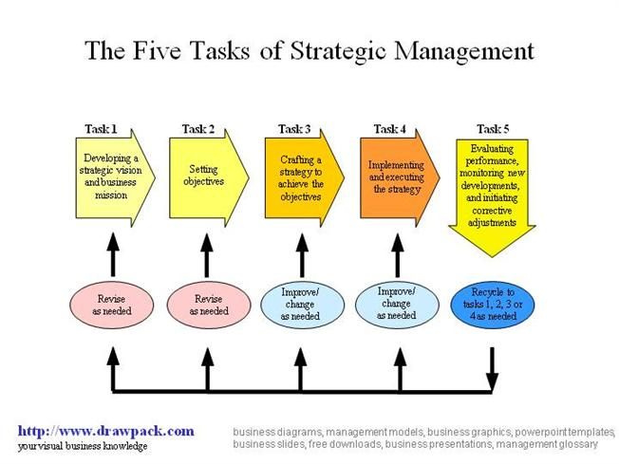

Slide 10
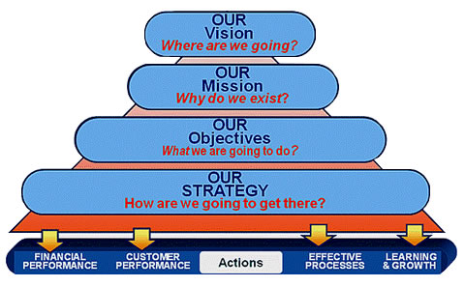

Slide 11
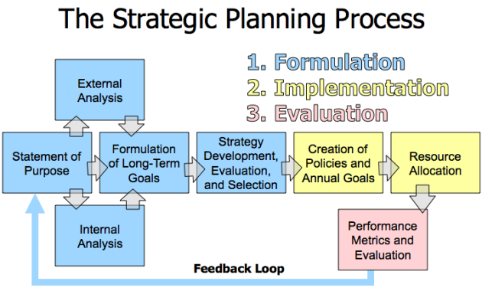

Slide 12
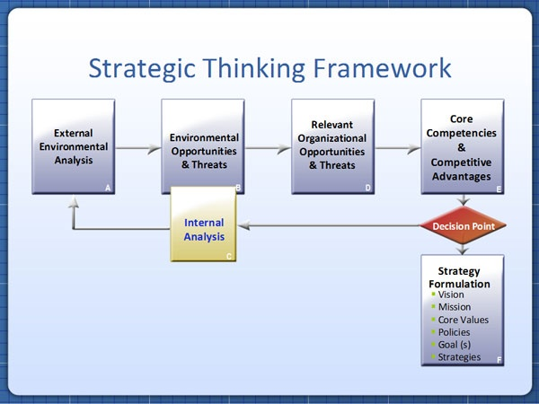

Slide 13
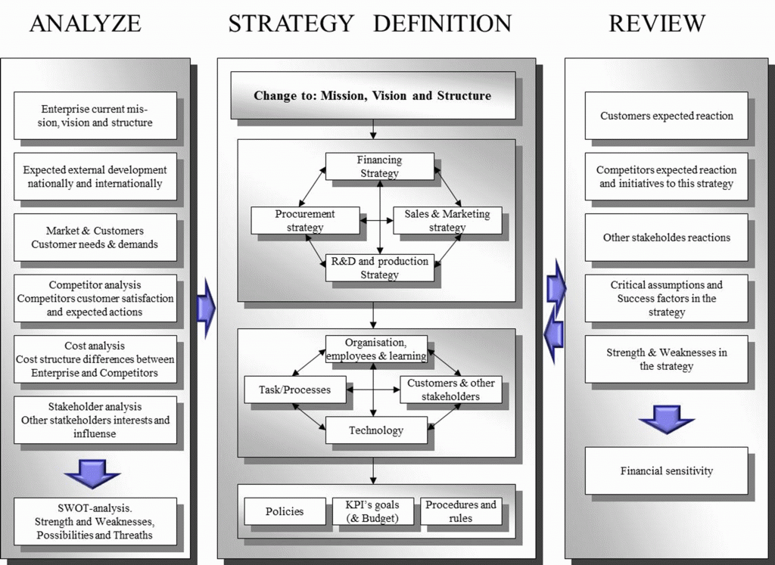

Slide 14
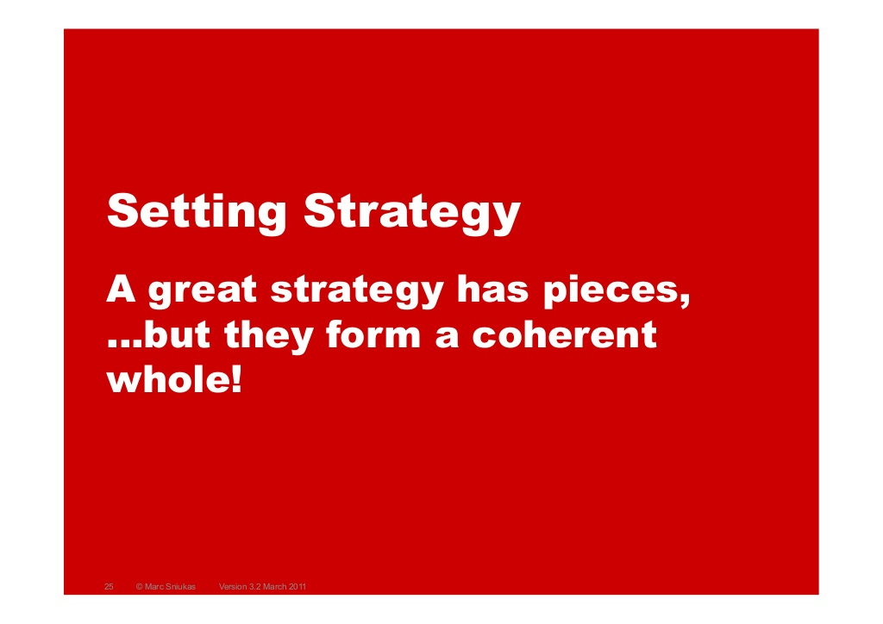

Slide 15
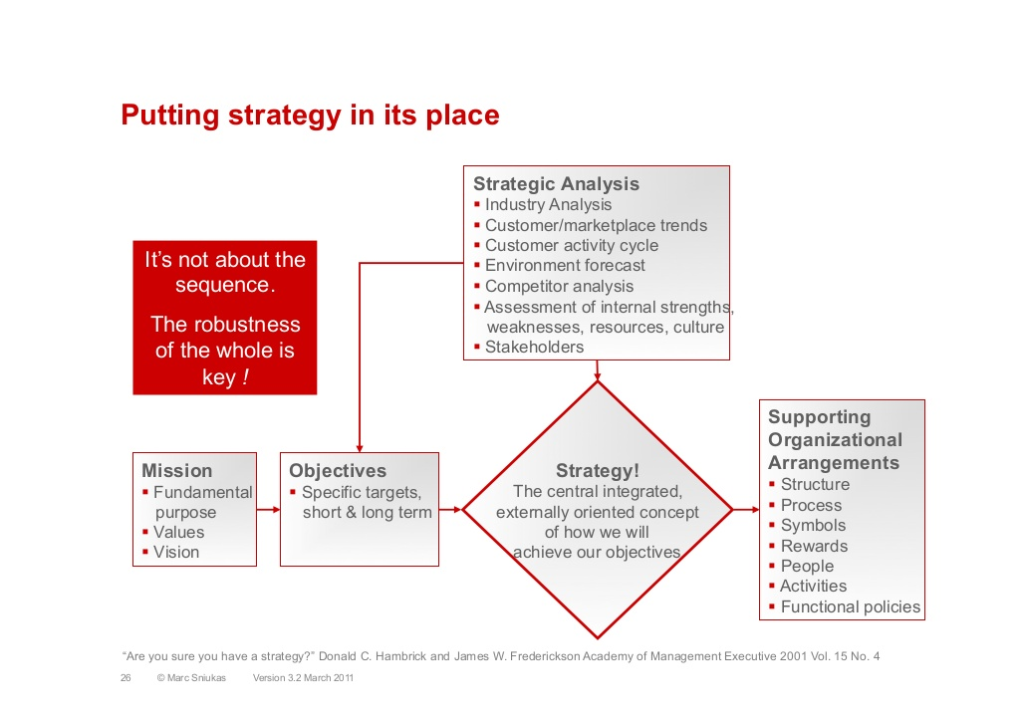

Slide 16
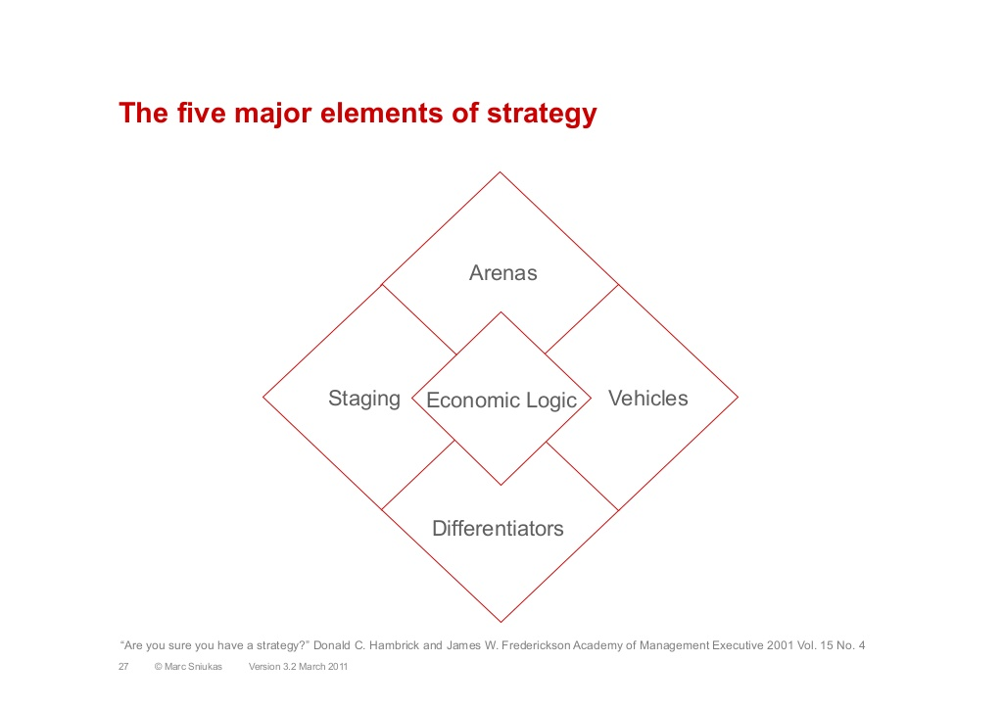

Slide 17
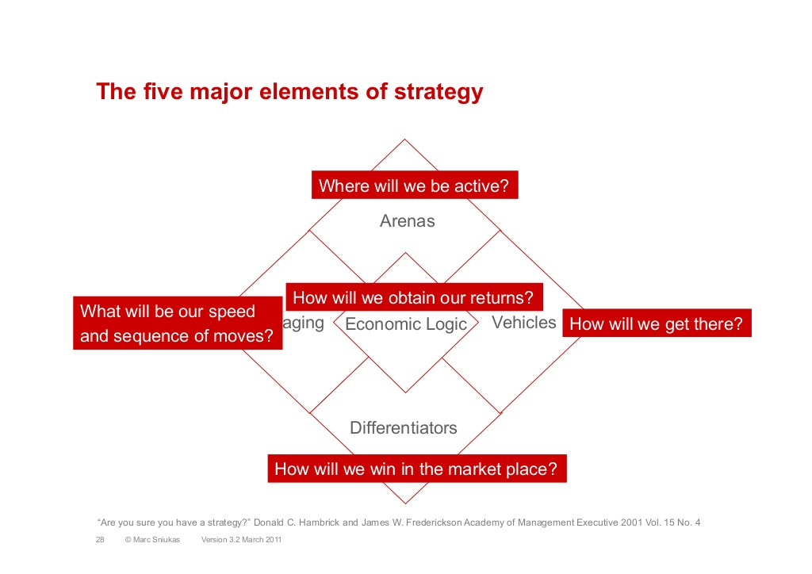

Slide 18
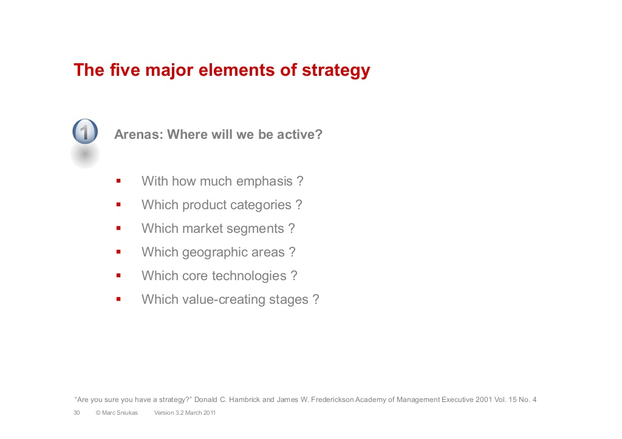

Slide 19
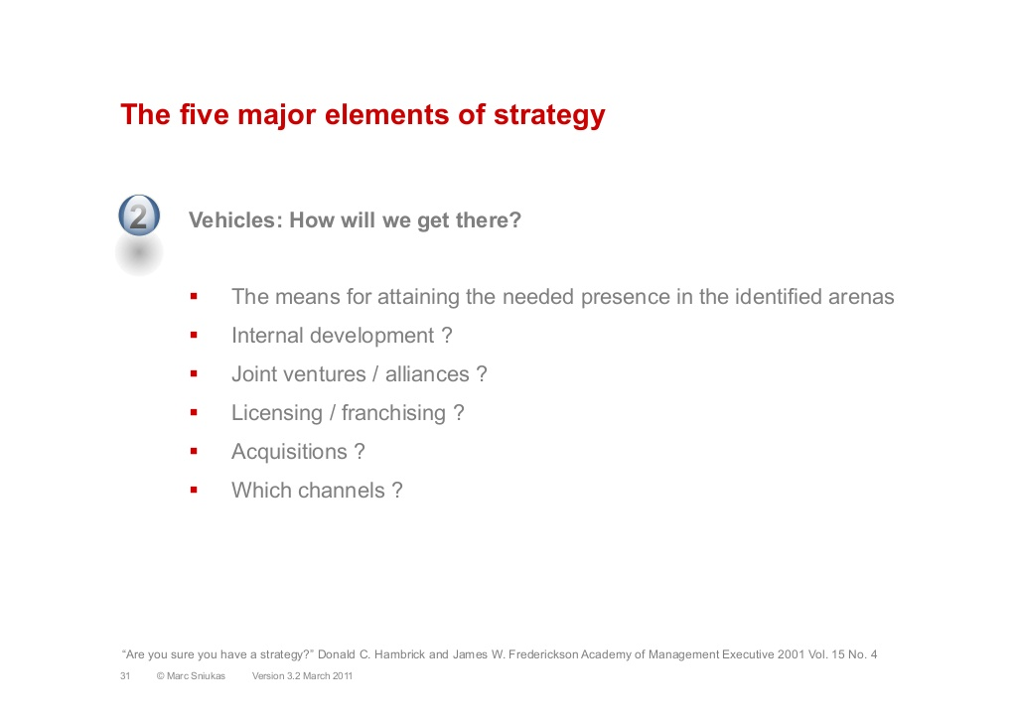

Slide 20
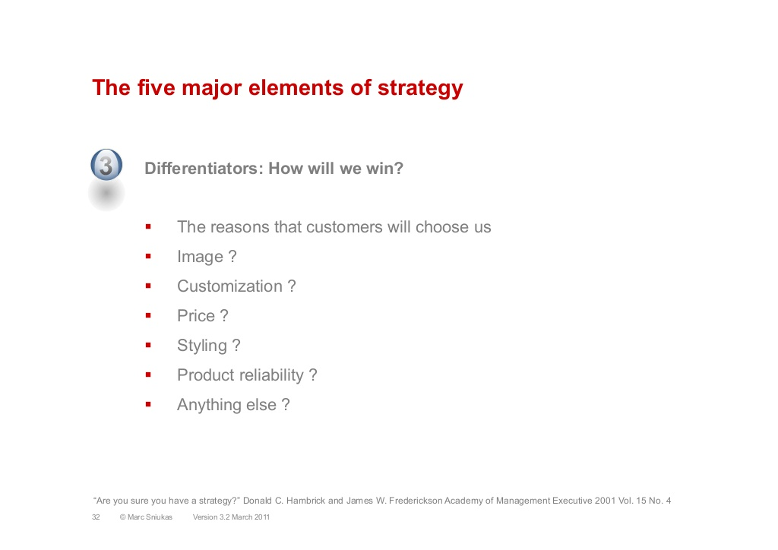

Slide 21
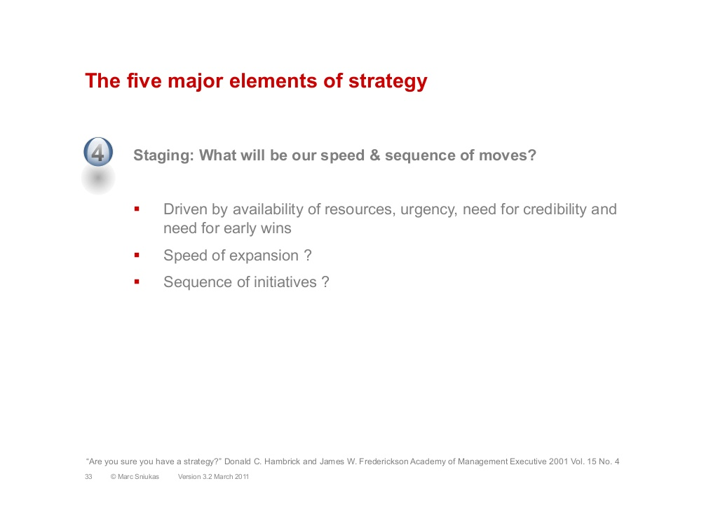

Slide 22
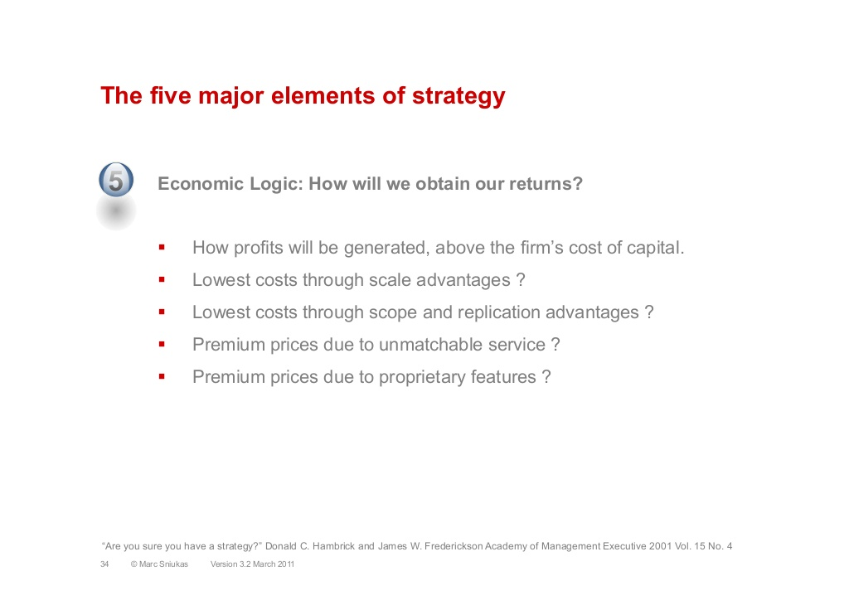
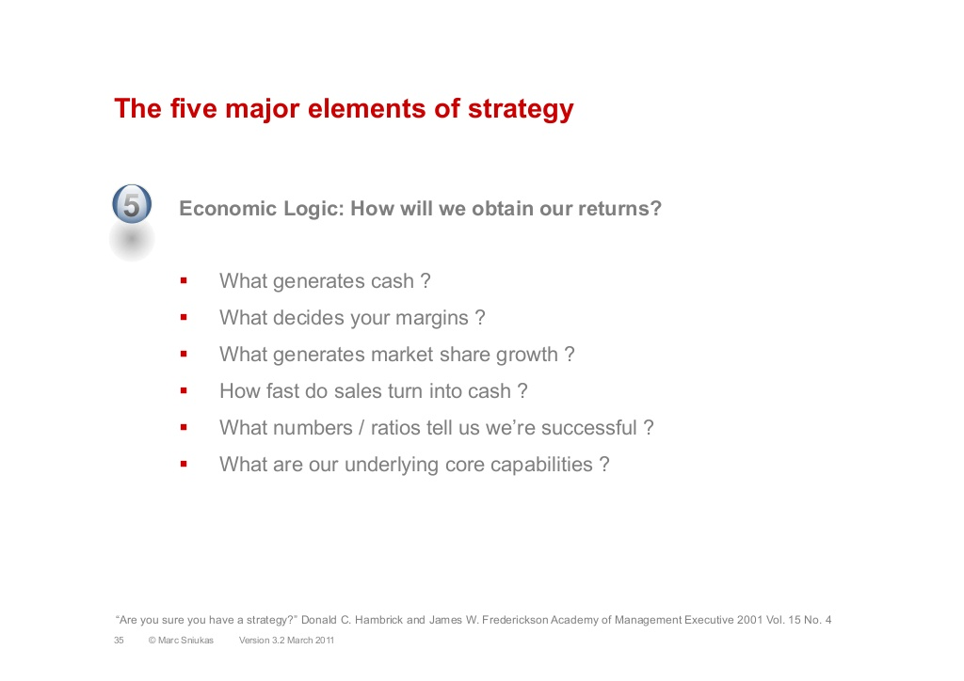

Slide 23
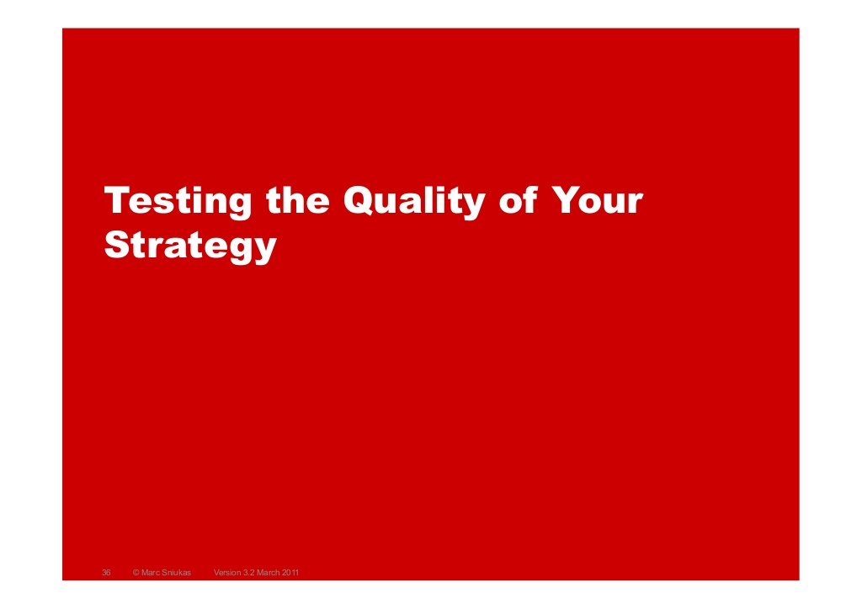

Slide 24
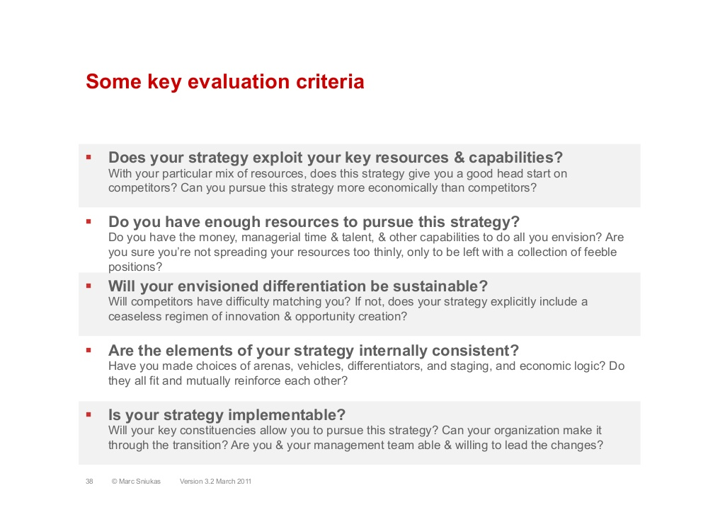

Slide 25
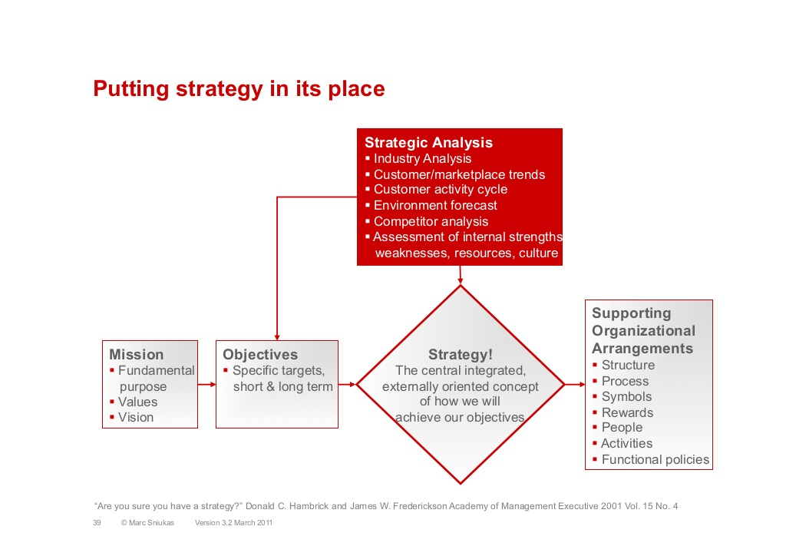

Slide 26
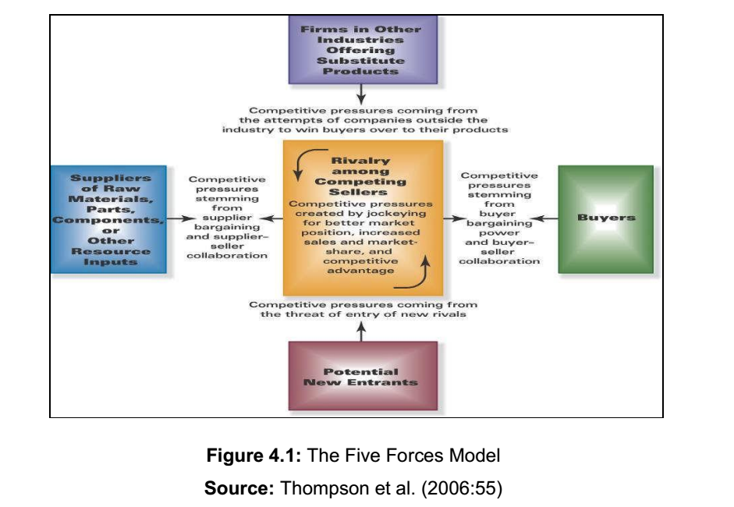
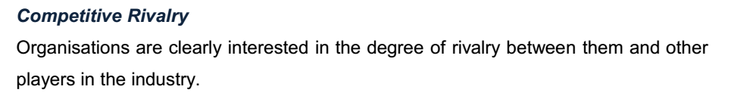
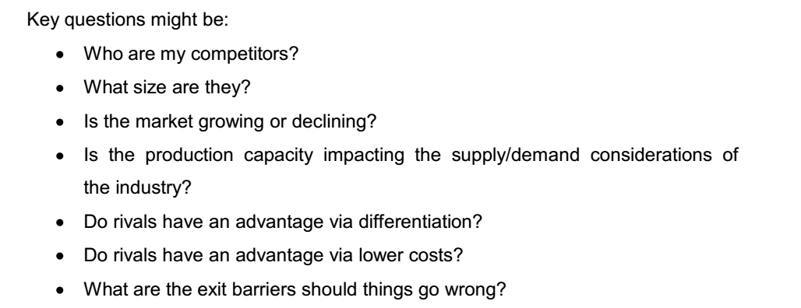

Slide 27
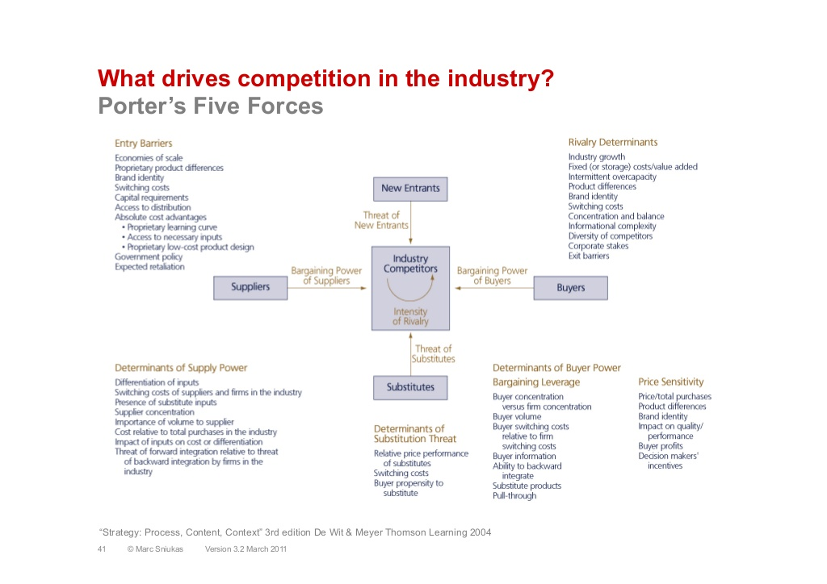

Slide 28
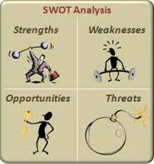

Slide 29
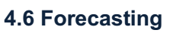
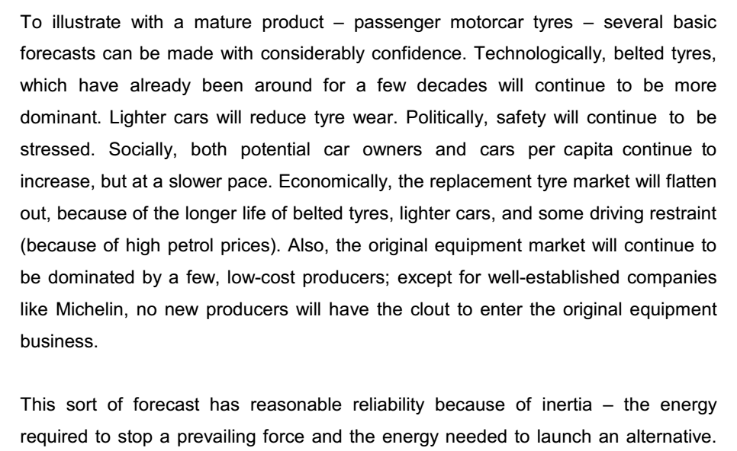
Peter Drucker once said: “The best way to predict the future is to create it”. Scenarios are a powerful way of moving towards a more desired future,

Slide 30
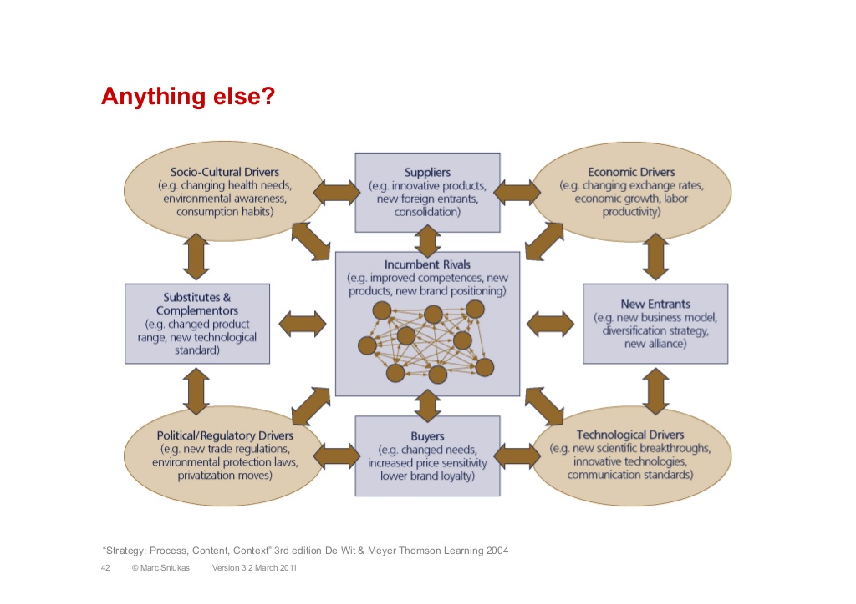

Slide 31
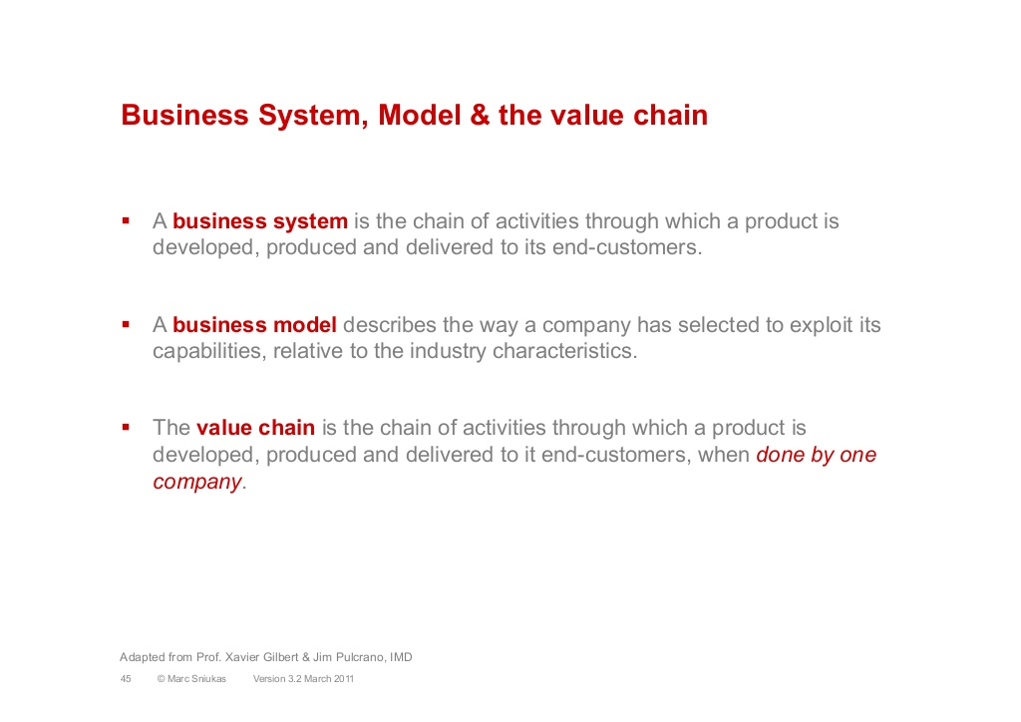

Slide 32
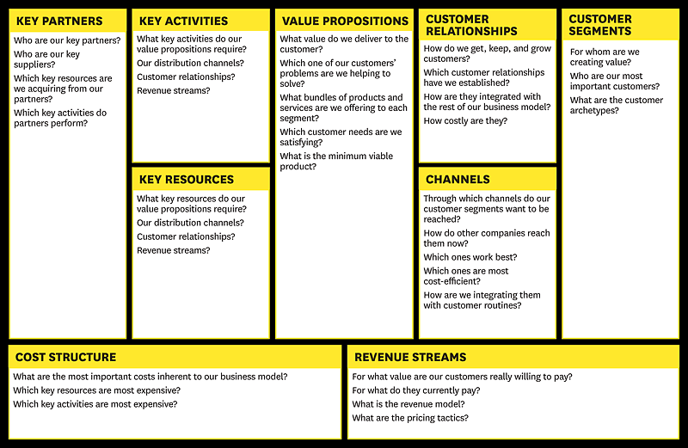
What’s your Business Model

Slide 33
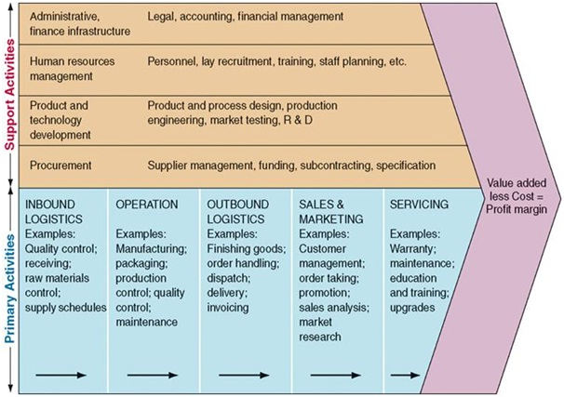
Analysing your company’s value chain

Slide 34
Achieving a Cost Advantage
Once you’re clearly defined your value chain for your proposed venture, then the next step is to perform a thorough cost analysis by assigning costs to each value chain activity. Porter mentioned 10 cost drivers where you might gain a cost advantage by controlling these drivers better your competitors.
Economies of Scale
Learning
Capacity utilization
Linkages between activities
Interrelationships between business units
Degree of vertical integration
Timing of market entry
Firms policy of cost or differentiation
Geographic location
Institutional factors (regulation, unions, taxes, etc)
- See more at: http://managementhelp.org/blogs/business-planning/2011/08/18/value-chain-your-way-to-profitability/#sthash.dWhGnZ7A.dpuf

Slide 35
Differentiation
Another way you can gain competitive advantage is through differentiation, which can occur anywhere in the value chain. Differentiation comes from providing unique value at some point in the value chain which lowers costs or improves the quality of the final product. Here’s Porter’s drivers of uniqueness:
Policies and decisions
Linkages among activities
Timing
Location
Interrelationships
Learning
Integration
Scale
Institutional factors
Finally, your company’s value chain links to the value chains of suppliers and buyers in a larger stream of activities that Porter calls the value system. Development of your competitive advantage will depend not only on your value chain, but also on the value system within which you will operate
- See more at: http://managementhelp.org/blogs/business-planning/2011/08/18/value-chain-your-way-to-profitability/#sthash.dWhGnZ7A.peWzytUs.dpuf

Slide 36
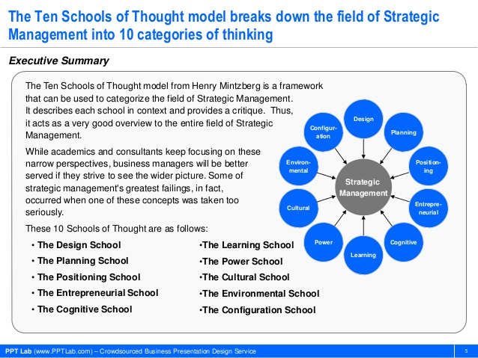

Slide 37
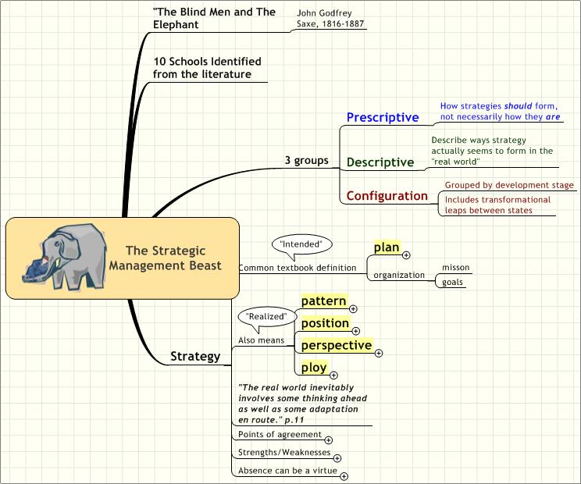

Slide 38
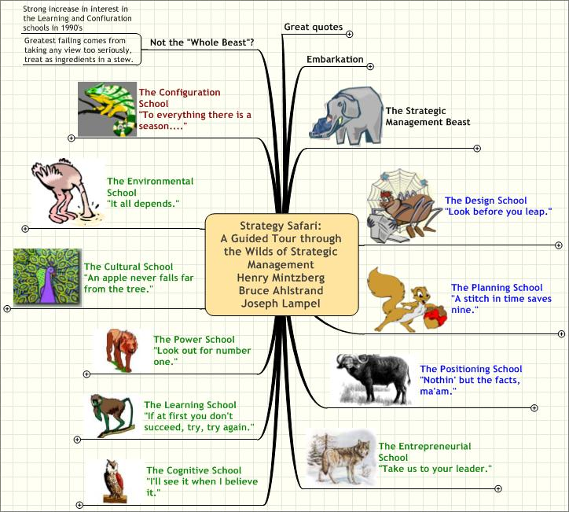

Slide 39
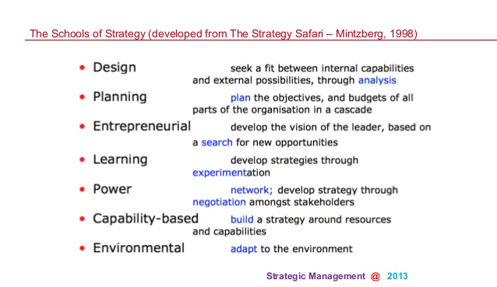

Slide 40
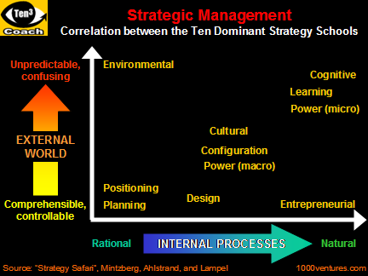

Slide 41
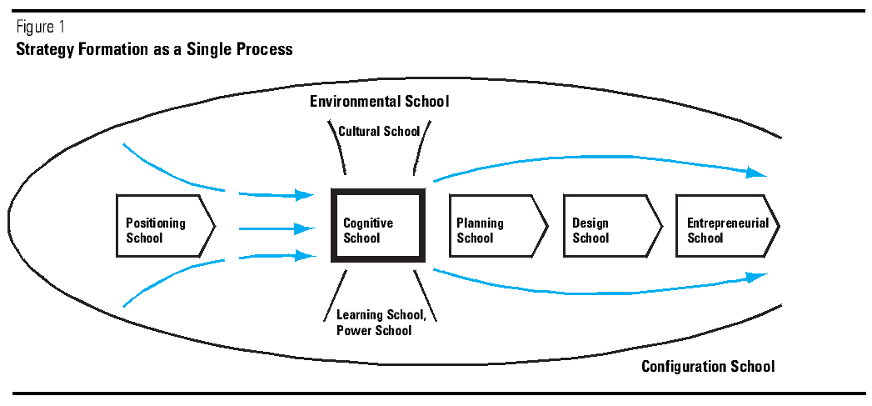

Slide 42
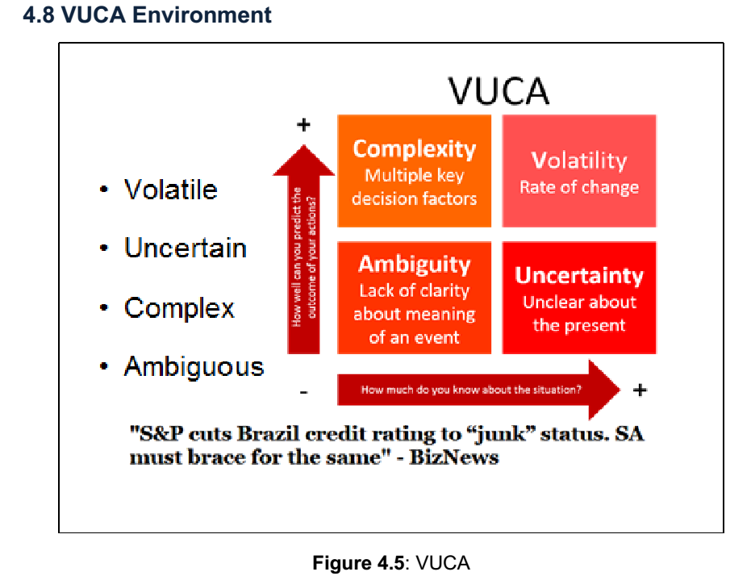
Actions
Situation

Slide 43
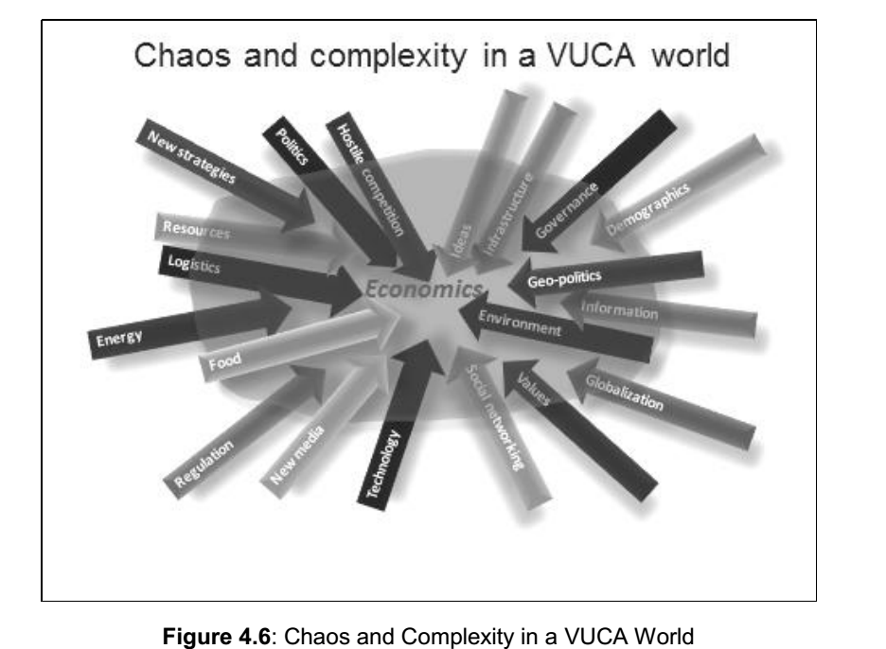

Slide 44
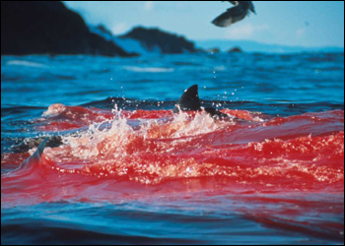

Slide 45
Two worlds …
Red Ocean
Compete in crowded markets
Blue Ocean
Create and capture new market space
Notes:
To win in the future New Market Space, companies must stop competing with each other.
Because the only way to beat the competition is to stop trying to beat the competition.
To understand this idea, imagine a market universe composed to two sorts of oceans:
-red oceans and
-blue oceans.

Slide 46
The Continuing Creation of Blue Oceans
Although the term blue oceans is relatively new, their existence is not. They are a feature of business life.
How many of today’s industries were unknown 100 years ago?
Now turn the clock back only 30 years….how many?

Slide 47
The Continuing Creation of Blue Oceans
Now put the clock forward twenty years and ask yourself how many now unknown industries will have appeared by then. If history can be used as a predictor of the future, again the answer is many of them.
The reality is that industries never stand still. They continuously evolve. Operations improve, markets expand, and players come and go.

Slide 48
The Continuing Creation of Blue Oceans
Blue Ocean Strategy provides a systematic approach to making the competition “irrelevant.”
Refer to Gary Hamel, strategy consultant and London Business School.

Slide 49
Value Innovation: The Cornerstone of Blue Ocean Strategy
Value creation alone improves value but is not sufficient to make you stand out in the marketplace
Innovation alone will often create a product that buyers are not willing to pay for
Value innovation occurs only when companies align innovation with utility, price, and cost positions
Value innovation:
Make the competition irrelevant
Create a leap in value for both buyers and your company
Open up new and uncontested market space

Slide 50
Unlocking non-customer demand
Value Innovation
Utility
Create new
buyer
utilities
Price
Set a price that
attracts a mass
of buyers
Cost
Set the structure based on a target

Slide 51
The Impact of Creating Blue Oceans
Business Launch
Revenue Impact
Profit Impact

Slide 52
Two worlds …
Red Ocean Strategy | Blue Ocean Strategy
Compete in existing market space. | Create uncontested market space.
Beat the competition. | Make the competition irrelevant.
Exploit existing demand. | Create and capture new demand.
Make the value-cost trade-off. | Break the value-cost trade-off.
Align the whole system of a strategic firm's activities with its choice of differentiation or low cost. | Align the whole system of a firm's activities in pursuit of differentiation and low cost. VALUE INNOVATION
Notes:
Red oceans represent all the industries in existence today. This is the known market space.
Blue oceans denote all the industries not in existence today. This is the unknown market space.
In the red oceans, industry boundaries are defined and accepted, and the competitive rules of the game are known. Here, companies try to outperform their rivals to grab a greater share of existing demand. As the market space gets crowed, prospects for profits and growth are reduced. Products become commodities, and cutthroat competition turns the red ocean bloody.
Blue Oceans, in contrast, are defined by untapped market space, demand creation, and the opportunity for highly profitable growth. Although some blue oceans are created well beyond existing industry boundaries, most are created from within red oceans by expanding existing industry boundaries. In blue oceans competition is irrelevant because the rules of the game are waiting to be set.
Logic of Blue Ocean Strategy is so called value innovation and is the cornerstone of Blue Ocean Strategy
Value innovation places equal emphasis on value and innovation. It is a new way of thinking about and executing strategy that results in the creation of a blue ocean and a break from the competition. Importantly, value innovation defies one of the most commonly accepted dogmas of competition-based strategy: The value-cost trade-off. → It is conventionally believed that companies can either create greater value to the customers at higher cost or create reasonable value at a lower cost. Here strategy is seen as making a choice between differentiation and low cost. In contrast , those that seek to create blue oceans pursue differentiation and low cost simultaneously.
Now turn the clock back only thirty years, How many industries of today's industries were then unknown? Mutual funds, cell phones, gas-fired electricity plants, biotechnology, discount retail, snowboards and coffee bars to name a few.

Slide 53
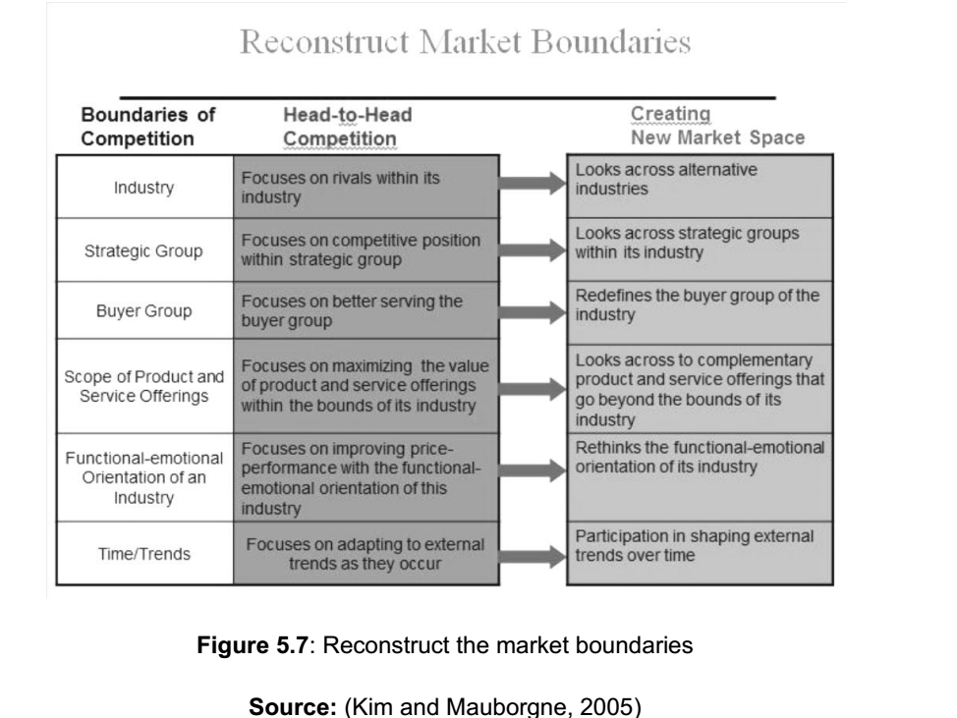

Slide 54
BOS Logic: Get the Strategic Sequence right
Buyer utility
Is there exceptional buyer
utility in your business idea?
No → Rethink
YES
Price
Is your price easily accessible to the mass of buyers?
No → Rethink
YES
Cost
Can you attain your cost target to profit at your strategic price?
No → Rethink
YES
Adoption
What are the adoption hurdles in actualizing your business idea?
Are you addressing them up front?
No → Rethink
YES
A commercially viable Blue Ocean Strategy
Notes:
This brings us to the fourth principle of the Blue Ocean Strategy: Get the strategic sequence right.
As shown in this figure, companies need to build their Blue Ocean Strategy in the sequence of buyer utility, price, cost, and adoption.
The starting point is buyer utility. Does your offering unlock exceptional utility? Is there a compelling reason for the mass of people to buy it?
Absent this, there is no Blue Ocean potential to begin with. Here there are only two options. Park the idea, or rethink it until you reach an affirmative answer.
When you clear the exceptional utility bar, you advance to the second step: setting the right strategic price. Remember a company does not want to rely on price to create demand. The key question her is this: Is your offering priced to attract the mass of target buyers so that they have a compelling ability to pay for your offering? If it is not, they cannot buy it. Nor will the offering create irresistible market buzz.
These two steps address the revenue side of a company's business model.
Securing the profit side bring the third element: cost. Can you produce your offering at the target cost and still earn a healthy profit margin? Can you profit at the strategic price-the price easily accessible to the mass of target buyers? You should not let costs drive prices. Nor should you scale down utility because high costs block your ability to profit at the strategic price. When the target cost cannot be met, you must either forgo the idea because the Blue Ocean won't be profitable, or you must innovate your business model to hit the target cost. It is the combination of exceptional utility, strategic pricing, and target costing that allows companies to achieve value innovation-a leap in value for both buyers and companies.
The last step is to address adoption hurdles. What are the adoption hurdles in rolling out your idea? Have you addressed these up front? The formulation of Blue Ocean Strategy is complete only when you address adoption hurdles in the beginning to ensure the successful actualization of your idea. Adoption hurdles include, for example, potential resistance to the idea by retailers or partners. Because Blue Ocean Strategies represent a significant departure from red oceans, it is key to address adoption hurdles up front.

Slide 55
Four Actions Framework: Key to Value Curve
Reduce
The key to discovering a new value curve lies in answering four basic questions
What factors should be reduced well below the industry standard?
Eliminate
Creating new markets:
A new value curve
Create/Add
What factors that the industry has taken for granted should be eliminated?
What factors that the industry has never offered should be created or added?
Raise
What factors should be raised well above the industry standard?

Slide 56
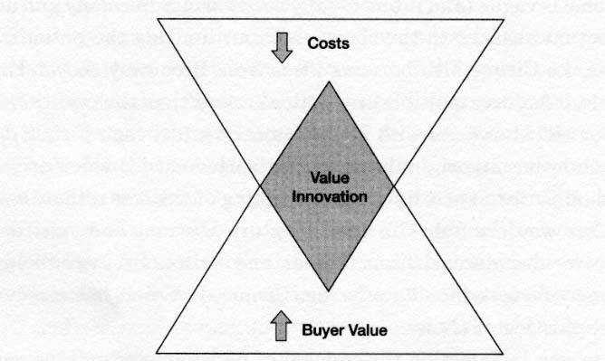
Value Innovation: The Cornerstone of Blue Ocean Strategy
Creators of blue oceans follow value innovation
Value Innovation
Equal emphasis on value and innovation
Defies value-cost trade-off of competition-based strategy
Successful value innovation:
Drives down costs while driving up buyers’ value
Uses a whole-system approach
Follows reconstructionist view

Slide 57
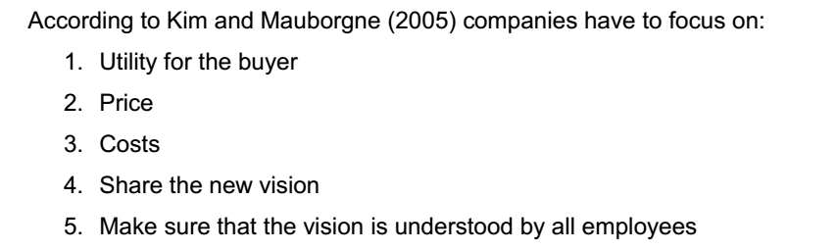

Slide 58
From Company and Industry to Strategic Move
So just how can a company break out of the red
ocean of bloody competition?
How can it create blue ocean?
Is there a systematic approach to achieve this
and thereby sustain high performance?

Slide 59
Value Innovation: The Cornerstone of Blue Ocean Strategy
What consistently separates winners from losers in creating blue oceans is their approach to strategy.
The firms caught in the red ocean followed a conventional approach of racing to beat the competition by building a defensible position within the existing industry order.

Slide 60
Value Innovation: The Cornerstone of Blue Ocean Strategy
The creators of blue oceans, don’t use the competition as their benchmark.
Instead, they follow a different strategic logic -value innovation.
Value innovation is the cornerstone of blue ocean strategy.
Focus on making the competition irrelevant as opposed to focusing on beating our competition.
Creating a leap in value for buyers and the firm by opening up new and uncontested market space.

Slide 61
The Six Principles of Blue Ocean Strategy
This figure highlights the six principles driving the successful formulation and execution of blue ocean strategy and the risks that these principles attenuate.
Formulation Principles | Risk factor each principle attenuates (strategy formulation)
Reconstruct market boundaries Focus on the big picture, not the numbers Reach beyond existing demand Get the strategic sequence right | Search risk Planning risk Scale risk Business model risk
Evaluation principles | Risk factor each principle attenuates (strategy execution)
Overcome key organizational hurdles Build execution into strategy | Organizational risk Management risk

Slide 62
Blue Ocean Strategy is Yellowtail Eliminate-Reduce-Raise-Create Grid
Eliminate:
Reduce:
Raise:
Create:
Enological terminology and distinctions
Aging qualities
Above-the-line marketing
Price versus budget wines
Retail store involvement
Wine complexity
Wine range
Vineyard prestige
Easy drinking
Ease of selection
Fun and adventure

Slide 63
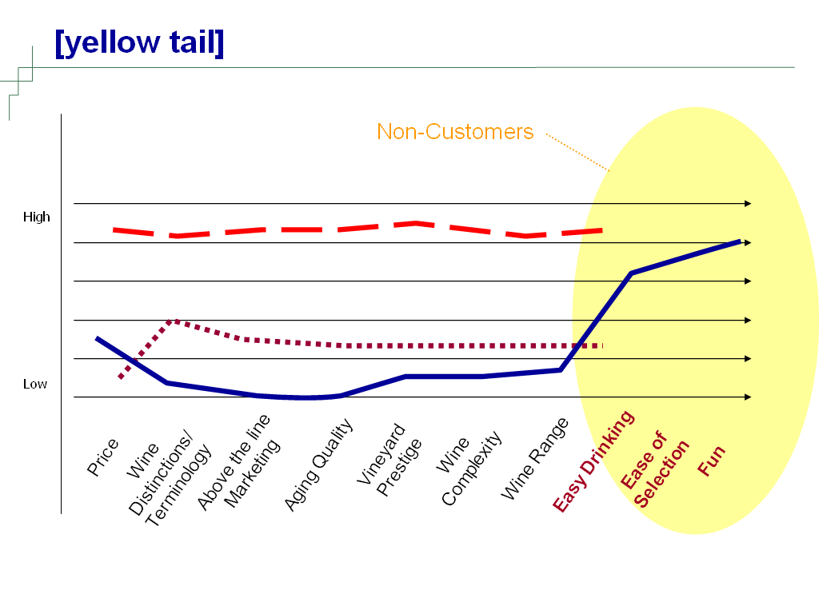
To Be Canvas
Eliminate
Reduce
Raise
Create

Slide 64
Value Innovation of [yellow tail]
Utility proposition (customers, distributors and retailers) | Creating of a social drink that is accessible to anyone Easy drinking, ease of selection, sense of fun and adventure Limit number of SKUs Price to move at volume
Price proposition | Targeted at the mass of customers Priced against the alternative (6-pack)
Cost structure | Elimination of working capital tied up in aging wines Fast product turnover

Slide 65
Results
No 1 imported wine (outsells France and Italy)
Fastest growing imported wine in the history of the USA industry
New consumers of wine
Jug drinkers trade up
Premium wine drinkers trade down
Industry criticizes them mercilessly at first
Now wine press blurb gives it a “best buy” for value; winning wine awards.

Slide 66
Three Characteristics of a Blue Ocean Strategy 1. Focus 2. Divergence 3. Compelling tagline These three characteristics serve as an initial litmus test of the commercial viability of the blue ocean ideas.

Slide 67
Reconstruct Market Boundaries aka Six Paths Framework There are six basic approaches to remaking market boundaries:
Look across alternative industries
Look across alternative groups within industries
Look across the chain of buyers
Look across complementary product / service offerings
Look across functional / emotional appeal to buyers
Look across time

Slide 68
Focus on the Big Picture; Not the Numbers
Think of a typical strategic plan.
It starts with a lengthy description of current industry conditions
and the competitive situation.
Next is a discussion of how to increase market share, capture new
segments, cut costs, followed by an outline of numerous goals and
Initiatives.
A full budget is attached as are lavish graphs and spreadsheets.

Slide 69
Focus on the Big Picture; Not the Numbers
The process usually culminates in the preparation of a bulky document
culled from a mishmash of data provided by people from various parts of
the organization who have conflicting agendas and poor communications.
In this process, managers spend the majority of strategic thinking time
filling in boxes and running numbers instead of thinking blue ocean and
developing a clear picture on how to break from the competition.
Students can see why very few strategic plans lead to the creation of
blue oceans or are translated into actions. Executives are paralyzed by
this muddle.
Few employees even know what the strategy is.

Slide 70
Focus on the Big Picture; Not the Numbers
A closer look reveals that most plans don’t include a strategy at all but
rather a smorgasbord of tactics that individually make sense but collectively
don’t add up to a unified clear direction that sets the company apart – let
alone makes the competition irrelevant.
Researchers and consultants have found that drawing a strategy canvas
not only visualizes a company’s current strategic position in the marketplace
but also helps to chart its future strategy.
By building a firm’s strategic planning process around a strategy canvas,
a company and its managers focus their main attentions on the big picture
rather than becoming immersed in numbers and jargon and getting caught
up in operational details.

Slide 71
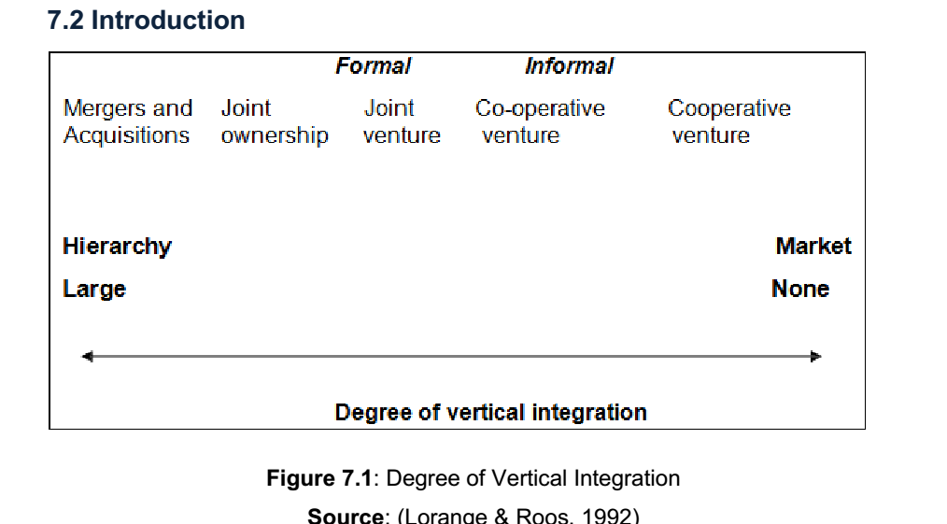
7. MERGERS AND ACQUISITIONS

Slide 72
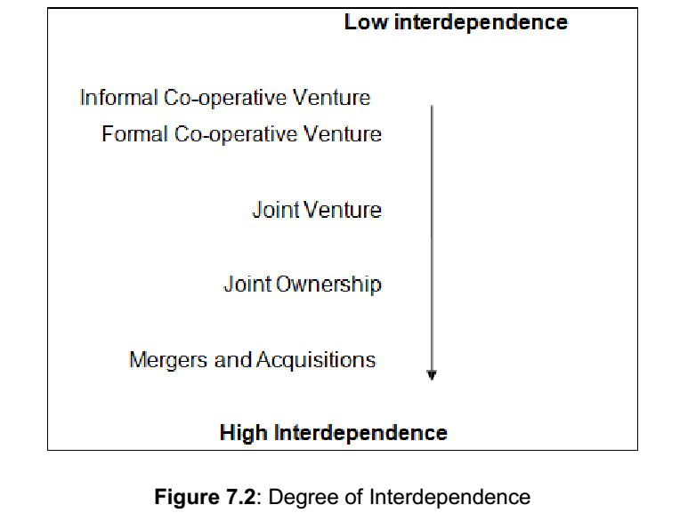

Slide 73
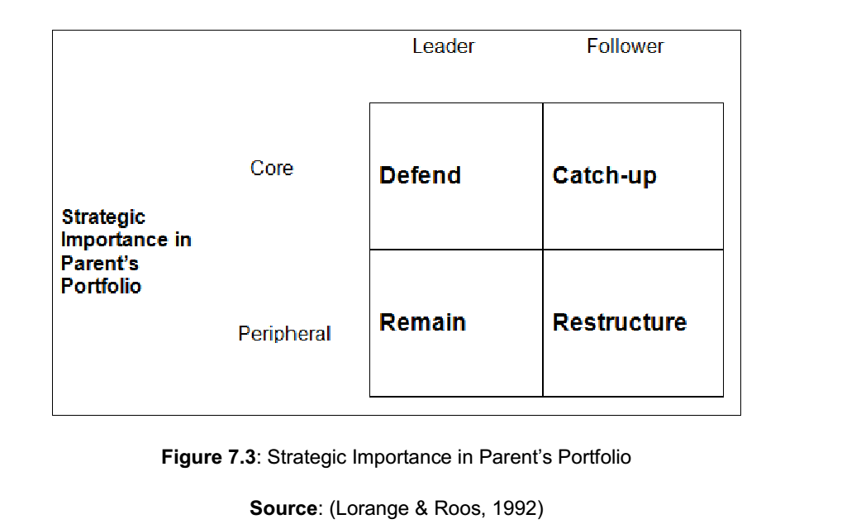

Slide 74
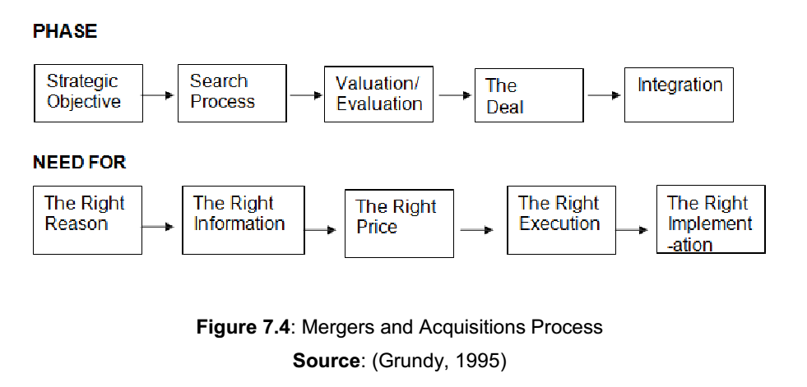

Slide 75
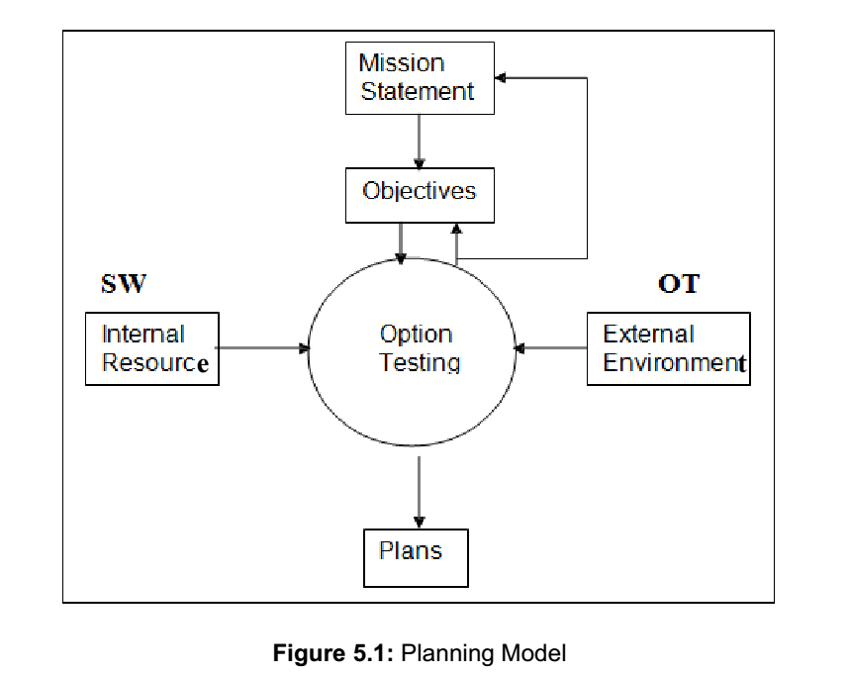
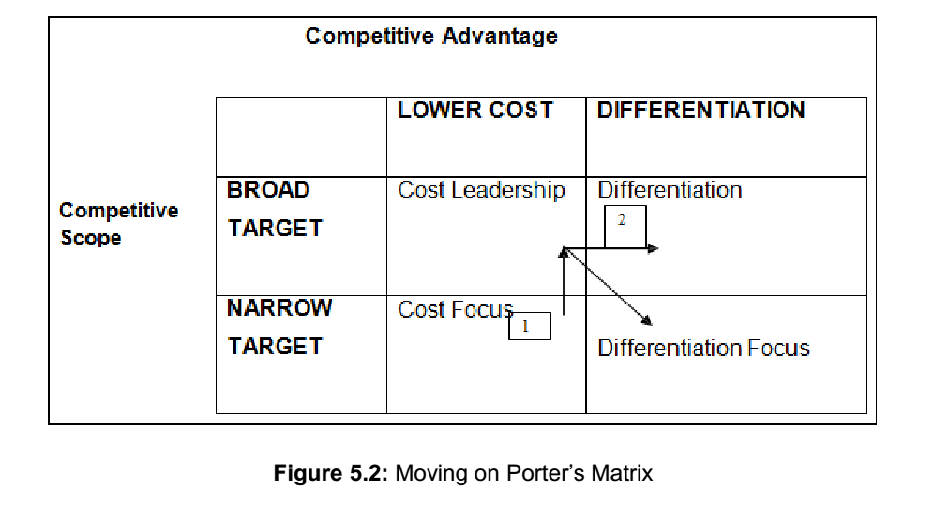
THE STRATEGY PROCESS: CRAFTING STRATEGY
There are also three stages in choosing a strategic direction: generating options evaluating options selecting a strategy.

Slide 76
Thank you

